Slide 1

Azure Cognitive Service
Broadview Consulting

Slide 2
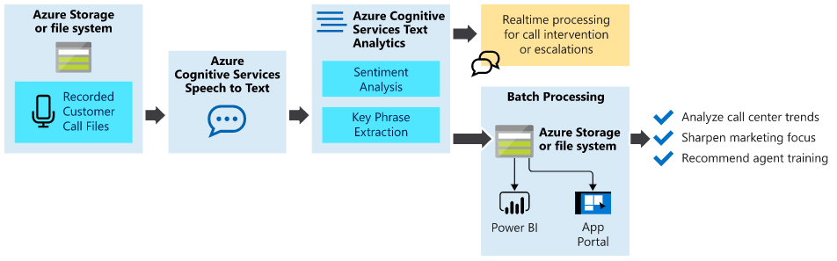
Analyze inbound customer calls

Slide 3

Commoditizing AI
Deep Learning
Reinforcement Learning
NLP
Agile in AI

Slide 4
Speech Recognition
Computational linguistics
Hidden Markov Model
Acoustic modeling
Geoffrey Hinton
Voice Assistant
Notes:
https://en.wikipedia.org/wiki/Speech_recognition#:~:text=Modern%20general%2Dpurpose%20speech%20recognition,a%20short%2Dtime%20stationary%20signal.

Slide 5
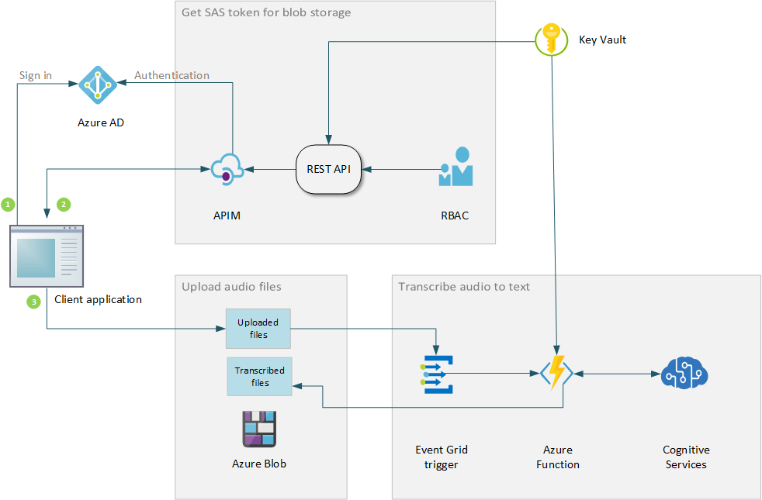
Cognitive Service Reference Architecture
Azure AD Authentication
RBAC
Azure Function
Trigger
BLOB Storage
Rest API
Cognitive Service
Notes:
https://docs.microsoft.com/en-us/azure/architecture/reference-architectures/ai/speech-ai-ingestion

Slide 6
Azure Subscription
Microsoft Account
Free account
Resource Group
Azure for Student

Slide 7

Speech Service Text Analytics Service App Service Deployment – CI/CD Version Control- GitHub ML Studio

Slide 8
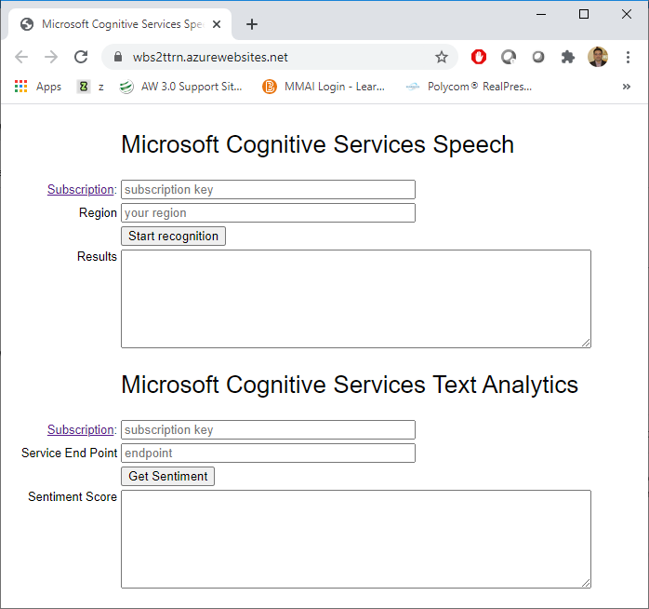
Real-time Sentiment Check
Copy Code to Local folder
Save in GitHub
Setup Deployment
CI/CD pipeline pushes the change to Azure
Enter the subscription key and Region
Browse the URL https://your_web_app_name.azurewebsites.net
GitHub link- https://github.com/BroadviewQueens/Speech2Text
Notes:
Copy below files:
index_from_microphone.html
microsoft.cognitiveservices.speech.sdk.bundle.js
token.php

Slide 9
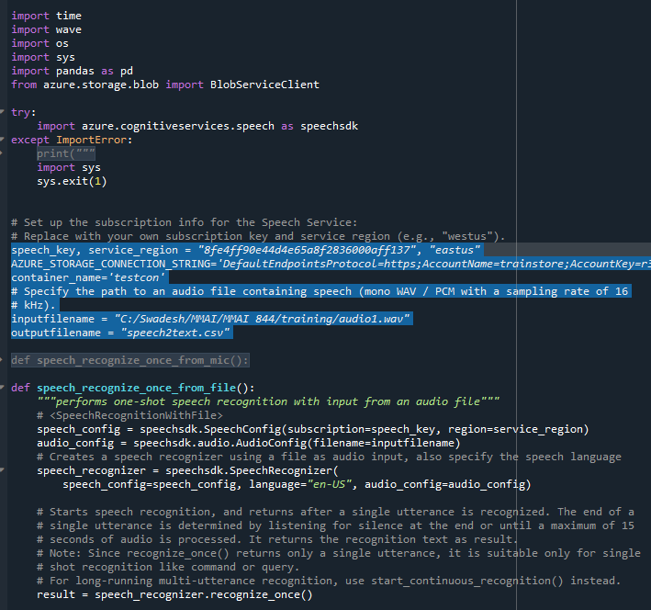
Python demo
Storage Account
Container
Storage Key
Speech-to-text key
Region
azure.cognitiveservices.speech
azure.storage.blob
Notes:
pip install azure.cognitiveservices.speech
pip install azure.storage.blob

